Slide 1
The Django Web Application Framework
zhixiong.hong
2009.3.26

Slide 2
Outline
Overview
Architecture
Modules
Example
Links

Slide 3
Outline
Overview
Architecture
Example
Modules
Links

Slide 4
Web Application Framework
Define
“A software framework that is designed to support the development of dynamic website, Web applications and Web services”(from wikipedia)
The ideal framework
Clean URLs
Loosely coupled components
Designer-friendly templates
As little code as possible
Really fast development

Slide 5
Web Application Framework(cont..)
Ruby
Ruby on Rails (famous, beauty)
Python
Django, TurboGears, Pylons, Zope, Quixote,web2py(simple)
PHP
CakePHP, CodeIgniter, PRADO, ThinkPHP,QeePHP (poor performance)
Others
Apache, J2EE, .NET...(complex)

Slide 6
Web Application Framework(cont..)
Comparsion

Slide 7
What a Django
“Django is a high-level Python web framework that encourages rapid development and clean, pragmatic design.”
Primary Focus
Dynamic and database driven website
Content based websites

Slide 8
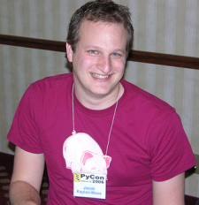
Django History
Named after famous Guitarist “Django Reinhardt”
Developed by Adrian Holovaty & Jacob Kaplan-moss
Open sourced in 2005
1.0 Version released Sep.3 2008, now 1.1 Beta

Slide 9
Why Use Django
Lets you divide code modules into logical groups to make it flexible to change
MVC design pattern (MVT)
Provides auto generated web admin to ease the website administration
Provides pre-packaged API for common user tasks
Provides you template system to define HTML template for your web pages to avoid code duplication
DRY Principle
Allows you to define what URL be for a given Function
Loosely Coupled Principle
Allows you to separate business logic from the HTML
Separation of concerns
Everything is in python (schema/settings)

Slide 10
Outline
Overview
Architecture
Modules
Example
Links

Slide 11
Django as an MVC Design Pattern
MVT Architecture:
Models
Describes your data structure/database schema
Views
Controls what a user sees
Templates
How a user sees it
Controller
The Django Framework
URL dispatcher

Slide 12
Architecture Diagram
Brower
Template
URL dispatcher
View
Model
DataBase

Slide 13
Model
Brower
Template
URL dispatcher
View
Model
DataBase

Slide 14
Model Overview
SQL Free
ORM
Relations
API

Slide 15
Model
class Category(models.Model):
name = models.CharField(max_length=200)
slug = models.SlugField(unique=True)
class Entry(models.Model):
title = models.CharField(max_length=200)
slug = models.SlugField(unique=True)
body = models.TextField()
data = models.DateTimeField(default=datetime.now)
categories = models.ManyToManyField(Category)
python manage.py syncdb

Slide 16
Model API
>>> category = Category(slug='django', name='Django')
>>> category.save()
>>> print category.name
u'Django'
>>> categories = Category.objects.all()
>>> categories = Category.objects.filter(slug='django')
>>> categories
[<Category: Category object>]
>>> entry = Entry(slug='welcome', title='Welcome', body='')
>>> entry.save()
>>> entry.categories.add( category[0] )
>>> print entry.categories.all()
[<Category: Category object>]

Slide 17
View
Brower
Template
URL dispatcher
View
Model
DataBase

Slide 18
View
def entry_list(request):
entries = Ebtry.objects.all()[:5]
return render_to_response('list.html', {'entries': entries})
def entry_details(request, slug):
entry = get_object_or_404(Entry, slug = slug)
return render_to_response('details.html', {'entry': entry})

Slide 19
Template
Brower
Template
URL dispatcher
View
Model
DataBase

Slide 20
Template Syntax
{{ variables }}, {% tags %}, filters (list.html)
<html>
<head>
<title>My Blog</title>
</head>
<body>
{% for entry in entries %}
<h1>{{ entry.title|upper }}</h1>
{{ entry.body }}<br/>
Published {{ entry.data|date:"d F Y" }},
<a href=”{{ entry.get_absolute_url }}”>link</a>.
{% endfor %}
</body>
</html>

Slide 21
Tag and Filter
Build in Filters and Tags
Custom tag and filter libraries
Put logic in tags
{% load comments %}
<h1>{{ entry.title|upper }}</h1>
{{ entry.body }}<br/>
Published {{ entry.data|date:"d F Y" }},
<a href=”{{ entry.get_absolute_url }}”>link</a>.
<h3>评论: </h3>
{% get_comment_list for entry as comment_list %}
{% for comment in comment_list %}
{{ comment.content }}
{% endfor %}

Slide 22
Template Inheritance
base.html index.html
<html>
<head>
<title>
{% block title %}
{% endblock %}
</title>
</head>
<body>
{% block body %}
{% endblock %}
</body>
</html>
{% extend “base.html” %}
{% block title %}
Main page
{% endblock %}
{% block body %}
Content
{% endblock %}

Slide 23
URL Dispatcher
Brower
Template
URL Dispatcher
View
Model
DataBase

Slide 24
URL Dispatcher
urlpatterns = patterns('',
#http://jianghu.leyubox.com/articles/
((r'^articles/$', ‘article.views.index'), )
#http://jianghu.leyubox.com/articles/2003/
(r'^articles/(?P<year>\d{4})/$', ‘article.views.year_archive'),
# http://jianghu.leyubox.com/articles/2003/ 12/
(r'^articles/(?P<year>\d{4})/(?P<month>\d{2})/$',
'article.views.month_archive'),
# http://jianghu.leyubox.com/articles/2003/ 12/3
(r'^articles/(?P<year>\d{4})/(?P<month>\d{2})/(?P<day>\d+)/$', 'article..views.article_detail'), )

Slide 25
Outline
Overview
Architecture
Modules
Example
Links

Slide 26
Modules
Form
Adminstration interface
Custom Middleware
Caching
Signals
Comments system
More...

Slide 27
Modules:Form
class ContactForm(forms.Form):
subject = forms.CharField(max_length=100)
message = forms.CharField(widget=forms.Textarea)
sender = forms.EmailField()
cc_myself = forms.BooleanField(required=False)
<form action="/contact/" method="POST">
{{ form.as_table}}
<input type="submit" value="Submit" />
</form>

Slide 28
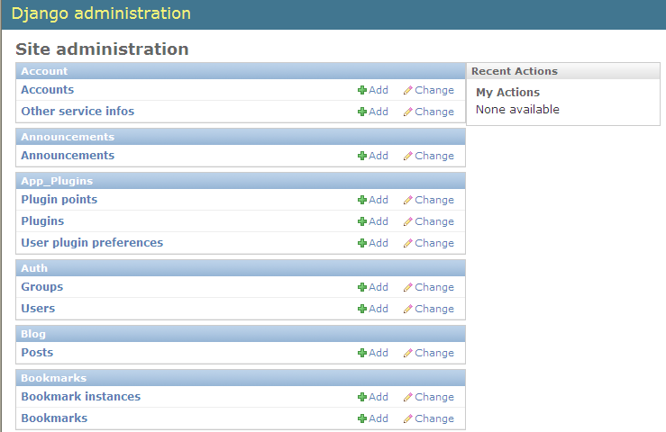
Modules:Adminstration interface

Slide 29
Modules: Custom Middleware
chain of processes
request
Common
Middleware
Session
Middleware
Authentication
Middleware
Profile
Middleware
response

Slide 30
Modules: Caching
Memcached
Database
Filesystem
Local-memory
Dummy
BaseCache
Per-Site Caching
Per-View Caching
template caching

Slide 31
Modules:More...
Sessions
Authentication system
Internationalization and localization
Syndication feeds(RSS/Atom)
E-mail(sending)
Pagination
Signals

Slide 32
Outline
Overview
Architecture
Modules
Example
Links

Slide 33
Example
django_admin startproject leyubbs
modify setting.py
set database options
append admin app: django.contrib.admin
python manager.py syncdb
python manager.py runserver
modify urls.py, append /admin path

Slide 34
Example(cont...)
python manager.py startapp article
add a model
python manager.py syncdb
explore admin page
inset a record in adminstration interface
add a veiw function
add a url

Slide 35
Outline
Overview
Architecture
Modules
Example
Links

Slide 36
Links: Who Use

Slide 37
Links: Resource
http://www.djangoproject.com/
For more information (Documentation,Download and News)
http://www.djangobook.com/
A Good book to learn Django
http://www.djangopluggables.com
A lot of Django Pluggables available online Explore at
http://www.pinaxproject.com/
Community Development

Slide 38
Thanks (Q&A)

